Slide 1
Wireless Ad-hoc Network
GROUP- 5
Muhammad Muntasir Arefin Chowdhury(C153047)
Muhammad Mahi-Al-Jawad(C153010)
Md. Mofasser Hossain(C153031)
Submitted to:
Abdullahil Kafi
Associate Professor, Dept of CSE
IIUC

Slide 2
What is Wireless Ad-hoc Network?
An ad-hoc network is a network that is composed of individual devices communicating with each other directly.
A wireless ad-hoc network (WANET) or MANET (Mobile ad hoc network) is a decentralised type of wireless network. The network is ad hoc because it does not rely on a pre-existing infrastructure, such as routers in wired networks or access points in managed (infrastructure) wireless networks.

Slide 3
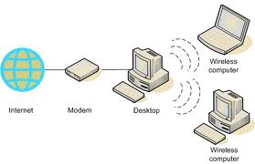
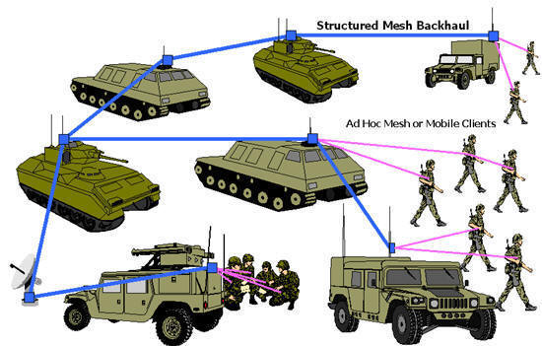
Types of WANETs
There are two types of Wireless Ad-hoc Networks.
Fixed Ad-hoc Networks.
Mobile Ad-hoc Networks(MANET).

Slide 4
Fixed Ad-hoc Wireless Networks
The nodes are stationary
The connections among the nodes are static
Example: Wireless Sensor Networks (WSNs):
Senor nodes collect certain information:
Temperature, humidity, voice, image, etc.
Route data packets to a central base station.
The network topology is fixed; unless a node:
Shuts down
Runs out of energy

Slide 5
Mobile of Ad Hoc Networks
The nodes are mobile.
The network topology is dynamic:
Node connectivity may vary with time due to:
The dynamic nature of the wireless medium
Node mobility, departure, new arrival, power outage, etc.
Hence, routing information changes accordingly.
Thus, efficient routing protocols are essential.

Slide 6
Characteristics
Do not rely on fixed infrastructure
No centralized administration
No single point of failure
Nodes are connected directly
Each node functions as both a host and a router
Hence, multi-hop routing is needed sometimes
Each node should be able to:
Detect the presence of other nodes
Identify the corresponding services and attributes
Handle topology changes and malfunctions in nodes

Slide 7
Why Ad-hoc Networks​?
No infrastructure needed
Can be deployed quickly, when no wireless communication infrastructure present
Can act as an extension to existing networks
Adaptive computing and self-configuring
Cost-effective

Slide 8
Applications
Public safety and emergency operations:
Search-and-rescue
Police and fire-fighter networks
Military environments:
Soldiers, tanks, planes, etc.
Civilian environments:
Taxi cab network
Meeting and conference rooms
Sports stadiums
Personal area networking:
Smartphone, PAD, laptop, headset, wrist watch, printer, etc.

Slide 9
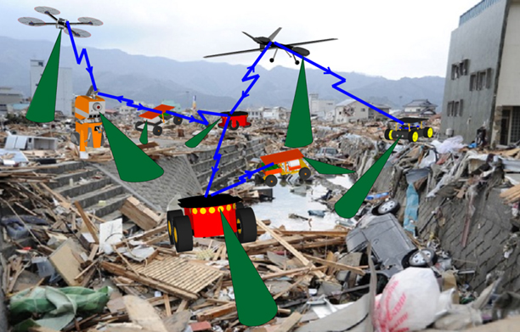
Search and Rescue Operations
Medical and rescue service during disasters:
Fast and effective communication
Real-time voice communication
Secure and reliable medical record exchange

Slide 10
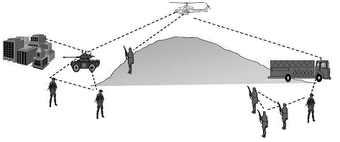
Military Battlefield
Quick and dynamic network setup:
No infrastructure
Highly-mobile (fast topology changes)
Distributed, diverse, and reliable network:
Fast adaptation to mobility and scale
No single point of failure
Secure and efficient communication
Support for multicast routing

Slide 11
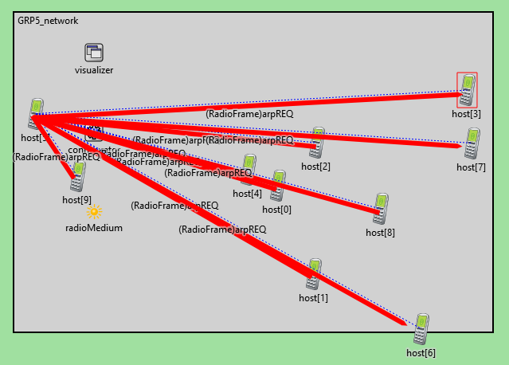
Our Network

Slide 12
Jazakallahu Khair….

